Slide 1
CREATING A DEMENTIA-FRIENDLY ENVIRONMENT

Slide 2
Code of Conduct
How are we going to to work together?
Treat each other with respect
Listen to each other
No personal comments
Contribute to the lesson(s)

Slide 3
Learning outcomes
By the end of this lesson, students will be able to…
Describe dementia, using appropriate language
Identify features of the built environment which may be difficult to navigate for a person with dementia.
Apply this information to the school environment and present how they would change an area of their school to be dementia-friendly.

Slide 4
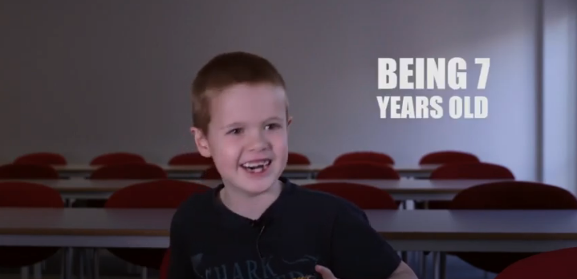
What is dementia?
In groups, can you describe dementia in a single sentence?
Would your sentence make sense to a 7 year old?
This film will give you an idea of how 7 year olds think.
https://youtu.be/609ZoEGcbjo

Slide 5


Dementia is…
…an umbrella term for a group of brain diseases which gradually effect the brain to the point at which a person’s ability to function in their daily life is increasingly impaired.
frontotemporal
dementia
Lewy body
dementia
vascular dementia
Parkinson’s disease dementia
alcohol-related
dementia

Slide 6
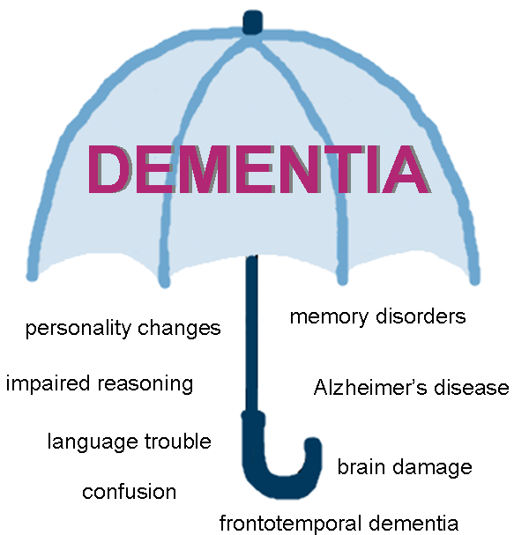
A word about dementia
Think of a word or phrase that describes dementia…
illness
forgetful
common
brain condition
confusion
older people

Slide 7
Dementia 5 key messages
Dementia is not a natural part of ageing
Dementia is caused by brain diseases
Dementia is not just about losing your memory
It’s possible to live well with dementia
There’s more to a person than dementia
For further information see: Dementia Friends
Important:
Dementia does not affect all old people.
Only about 7% of people over the age of 65, have dementia.
Although this rises to nearly 17% (1:6) over the age of 80.

Slide 8

Quick Quiz
Please complete the 7 questions.
Please ✓ answer for each question
People with dementia can ….

Slide 9
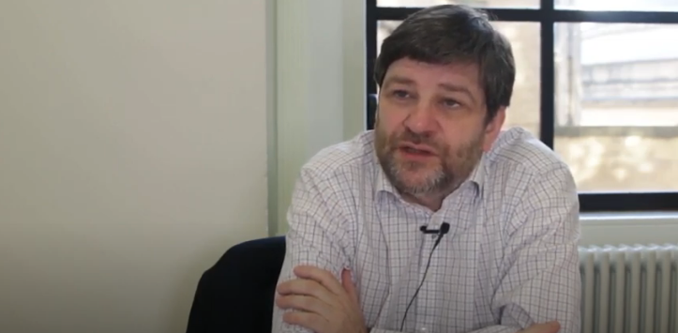
Dementia-friendly environments The built environment
Paul McGarry, Manchester City Council
https://youtu.be/_KjPKp6nWuA
Notes:
Find out more about Age Friendly Manchester here: http://www.manchester.gov.uk/info/200091/older_people/7116/our_age-friendly_work

Slide 10
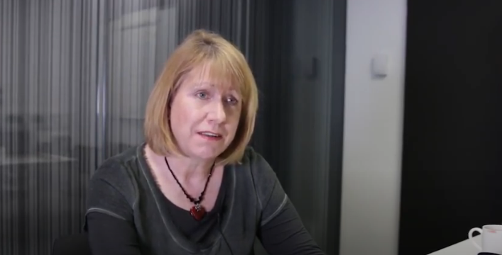
Dementia-friendly environments The hospital environment
Prof Josie Tetley, Manchester Metropolitan University
https://youtu.be/LRLNFg5aRQQ

Slide 11
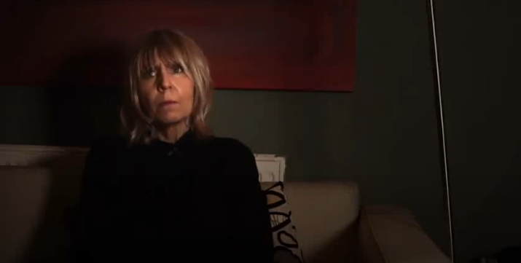
Dementia-friendly environments The home environment
Lesley discusses the challenges at home
https://youtu.be/SIa7v3moCrI

Slide 12
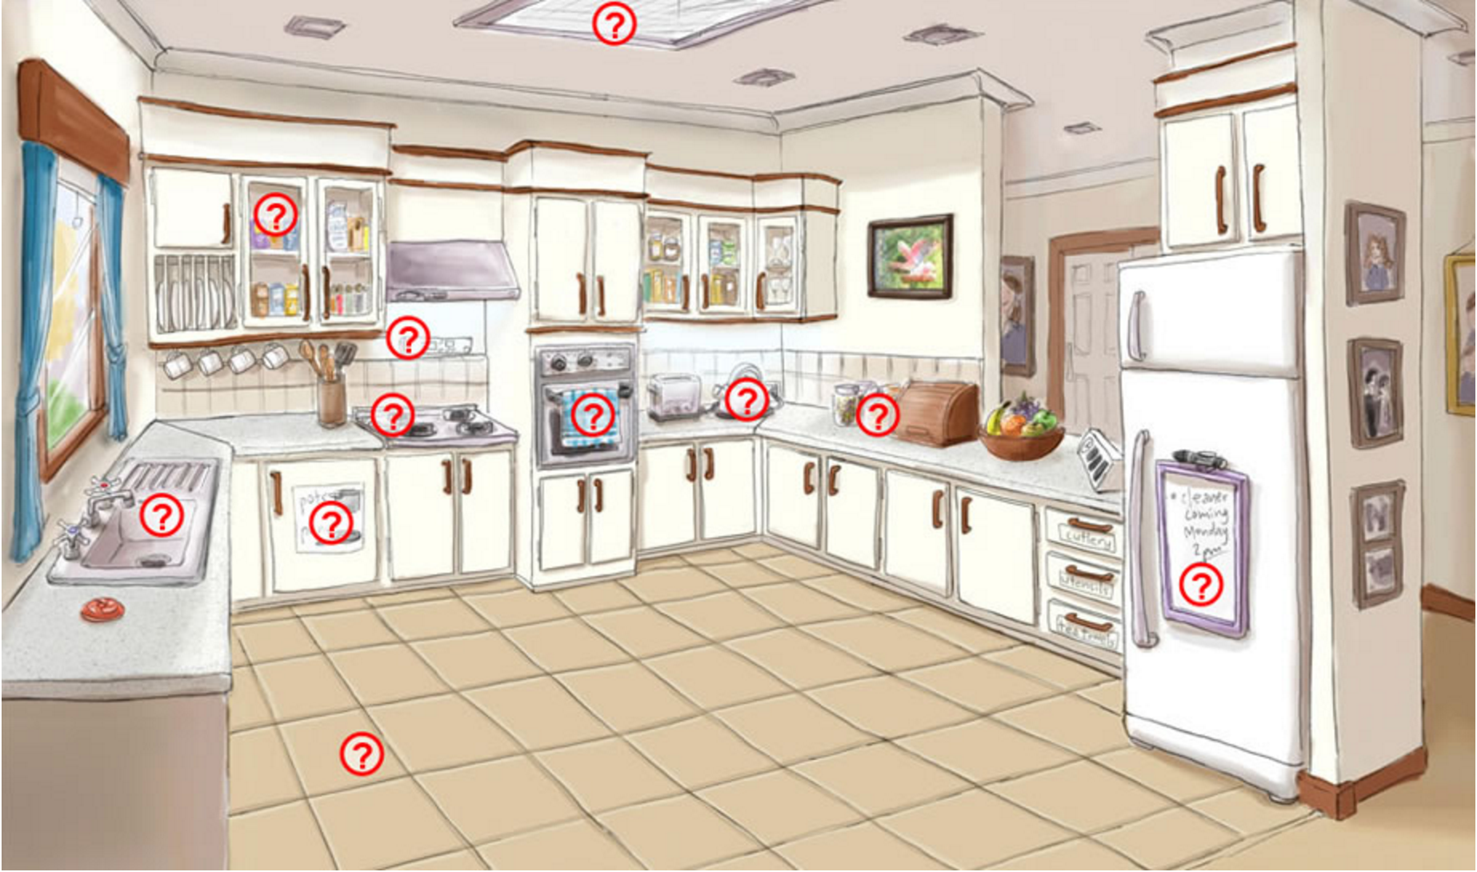
In the kitchen
Image courtesy of: www.enablingenvironments.com.au/

Slide 13
In the kitchen
Image courtesy of: https://www.enablingenvironments.com.au/kitchen1.html
‘Water-flow monitors, flood detectors and pressure activated plugs can help reduce incidences of flooding and water related slips and falls’
- Alzheimer’s WA (Western Australia).

Slide 14
In the kitchen
Image courtesy of: www.enablingenvironments.com.au/
‘Frequently used items should be placed on the kitchen bench top or open shelf’
‘Provide opportunities for domestic activities like making a cup of tea’
- Alzheimer’s WA (Western Australia).

Slide 15
In the kitchen
Image courtesy of: www.enablingenvironments.com.au/
‘Use labels with words/images to help make finding things easier’
‘A white board can be used for shopping lists, reminders and important messages’
- Alzheimer’s WA (Western Australia).

Slide 16
Over to you…
Choose an area of your school and decide how you would make it dementia-friendly.
Be prepared to present your ideas to the rest of the class.

Slide 17
Quick Quiz
Please look at the 7 questions again.
This time put an x for the correct answer
And then complete the Reflection ….

Slide 18
DESIGNING AN INTERGENERATIONAL EVENT

