Slide 1
DESIGNING AN INTERGENERATIONAL EVENT

Slide 2
Code of Conduct
How are we going to to work together?
Treat each other with respect
Listen to each other
No personal comments
Contribute to the lesson(s)

Slide 3
Learning outcomes
By the end of this lesson, students will…
Be able to describe dementia, using appropriate language
Understand the considerations that need to be made when planning an event for older people, especially those living with dementia
Have designed and planed an event for people living with dementia and will be able to identify the elements of their event that make it dementia-friendly.

Slide 4
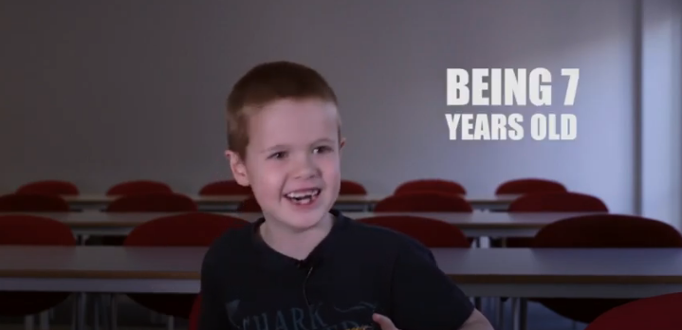
What is dementia?
In groups, can you describe dementia in a single sentence?
Would your sentence make sense to a 7 year old?
This film will give you an idea of how 7 year olds think.
https://youtu.be/609ZoEGcbjo

Slide 5
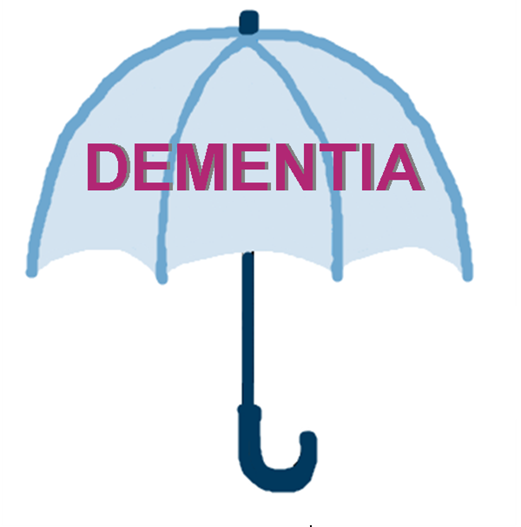

Dementia is …
… an umbrella term for a group of brain diseases which gradually effect the brain so that a person’s ability to function in their daily life is increasingly impaired.
frontotemporal
dementia
Lewy body
dementia
vascular dementia
Parkinson’s disease dementia
alcohol-related
dementia

Slide 6
Dementia 5 key messages
Dementia is not a natural part of ageing
Dementia is caused by brain diseases
Dementia is not just about losing your memory
It’s possible to live well with dementia
There’s more to a person than dementia
For further information see: Dementia Friends
Important:
Dementia does not affect all old people.
Only about 7% of people over the age of 65, have dementia.
Although this rises to nearly 17% (1:6) over the age of 80.

Slide 7
Learning outcomes
By the end of this lesson, students will…
Be able to describe dementia, using appropriate language;
Understand the considerations that need to be made when planning an event for older people, especially those living with dementia
Have designed and planed an event for people living with dementia and will be able to identify the elements of their event that make it dementia-friendly

Slide 8
Intergenerational
“Intergenerational practice aims to bring people together in purposeful, mutually beneficial activities …
… which promote greater understanding and respect between generations and contributes to building more cohesive communities.
Intergenerational practice is inclusive, building on the positive resources that the young and old have to offer each other and those around them.”
- Beth Johnson Foundation

Slide 9
What’s my current thinking?
- - - - - -
Planning an event for older people aged 65+ (including those who have dementia)
- - - - - -

Slide 10
What are the benefits of intergenerational events?
For older people?
For young people?
Notes:
Ask the students to think of the benefits of intergenerational events to all audiences.

Slide 11
Some benefits of intergenerational events:
Reducing (or perhaps eradicating) age-related stereotypes (for both young and old!)
Older people learning from younger people about technology and what life is like for young people in the modern era
Giving young people a chance to speak to and learn from older people, particularly if they don’t have any grandparents or elders in their lives
Creating a more connected community
Notes:
Young people may perceive older people (and particularly people with dementia) as immobile, slow, and spend most of their time asleep. Older people can perceive young people as disinterested and unaware, and not realise the shift in social pressures since they were children. Intergenerational events can help both parties to break these perceptions, learning from and appreciating each other.

Slide 12
What are the benefits of intergenerational events?
For older people?
For young people?
For people living with dementia?
Notes:
Ask the students to think of the benefits of intergenerational events to all audiences.

Slide 13
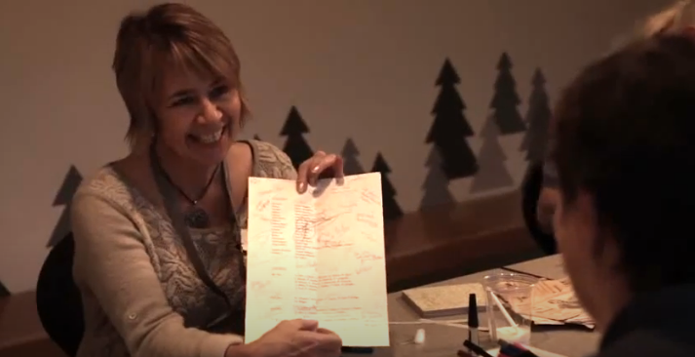
Coffee, Cake and Culture
At the Whitworth Art Gallery in Manchester
https://youtu.be/NbZPyICo5d8

Slide 14
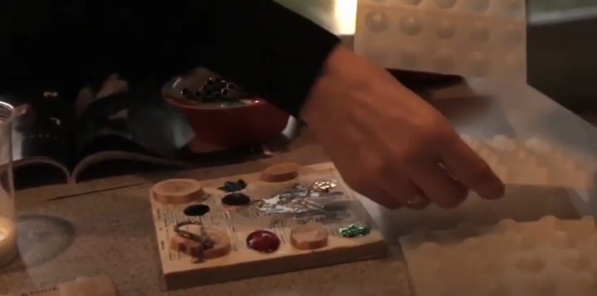
Kate Eggleston-Wirtz
and Fabulous Forgetful Friends
https://youtu.be/_fnrmlPYOcI

Slide 15
Some benefits of intergenerational events:
Reducing the social isolation of people with dementia
Eradicating age-related stereotypes (for both young & old!)
Older people learning from younger people about technology and what life is like for young people in the modern era
Giving young people a chance to speak to and learn from older people, particularly if they don’t have any grandparents or elders in their lives
Creating a more connected community
Notes:
Young people may perceive older people (and particularly people with dementia) as immobile, slow, and spend most of their time asleep. Older people can perceive young people as disinterested and unaware, and not realise the shift in social pressures since they were children. Intergenerational events can help both parties to break these perceptions, learning from and appreciating each other.

Slide 16
What types of events do you think would appeal to older people?
Notes:
Ask the students to think of the benefits of intergenerational events to all audiences.

Slide 17
Party planner
Planning a party for a 70 year old…
Who would you invite?
What activities would you involve?
What music would you play?

Slide 18
Designing an intergenerational event
Things to consider:
The format of your event
The venue and accessibility
The time of day
Resources required
Who would be involved
… and why would it work?

Slide 19
Designing an intergenerational event
Feedback to the group:
The format of your event
The venue and accessibility
The time of day
Resources required
Who would be involved?
… and why would it worth doing?

Slide 20
What do I now think?
- - - - - -
Planning an event for older people aged 65+ (including those who have dementia)
- - - - - -

Slide 21
DESIGNING AN INTERGENERATIONAL EVENT

