Slide 1
WHAT IS DEMENTIA?

Slide 2
Learning outcomes
By the end of this lesson, students will:
Have reflected on their own knowledge of, and values about dementia
Be able to describe dementia, using appropriate language;
Understand Dementia Friends’ key messages around dementia;
Have reflected on how dementia is portrayed in the media and how this might conflict with the key messages.

Slide 3
Introductions
Our code of conduct
Help is available
Dementia quiz

Slide 4
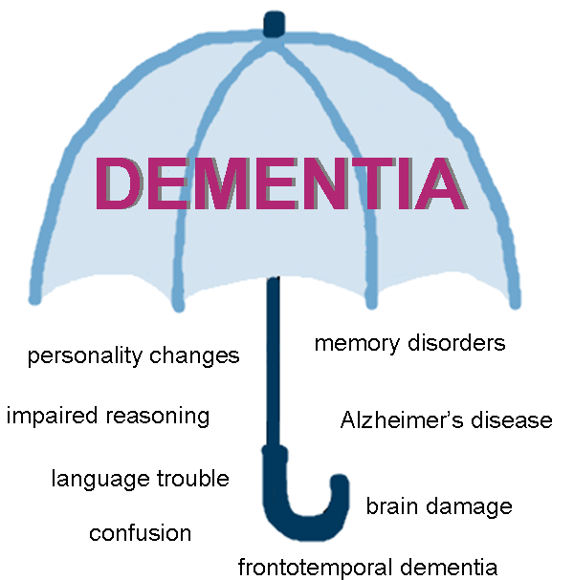
Dementia is …
Dementia is an umbrella term for diseases which cause degeneration of the brain over time.

Slide 5
A word about dementia
Think of a word or phrase that describes dementia…
illness
common
forgetful
confusion
brain condition
older people

Slide 6
The bookcase analogy
In this film from the Alzheimer’s Society, Dementia Friends Champion Natalie talks through the ‘bookcase analogy’.
The analogy can help you to understand the way dementia affects a person.
https://www.youtube.com/watch?v=kkvyGrOEIfA&t=3s
Notes:
Further information from the Alzheimer’s Society
The ‘bookcase analogy’ is one aspect of a Dementia Friends Information Session. These are friendly and interactive 45 minute – 1 hour Sessions in which you learn more about dementia and some of the actions you can take to help people living with dementia. The Sessions are open to everyone. To find a Session near you, visit http://www.dementiafriends.org.uk. Alzheimer’s Society’s Dementia Friends programme is the UK’s biggest ever initiative to change people’s perceptions of dementia. Dementia touches the lives of millions of people across the UK. Dementia Friends was launched to tackle the stigma and lack of understanding that means many people with the condition experience loneliness and social exclusion. We need to create more communities and businesses that are dementia friendly so that people affected by dementia feel understood and included. Whether you attend a face-to-face Information Session or watch the online video, Dementia Friends is about learning more about dementia and the small ways you can help. From telling friends about Dementia Friends to visiting someone you know living with dementia, every action counts. Find out more at http://www.dementiafriends.org.uk

Slide 7
Dementia in the media
How is dementia often described in the media?
What is the tone of the coverage?
How does the media talk about people with dementia?
How old are people with dementia usually assumed to be?

Slide 8
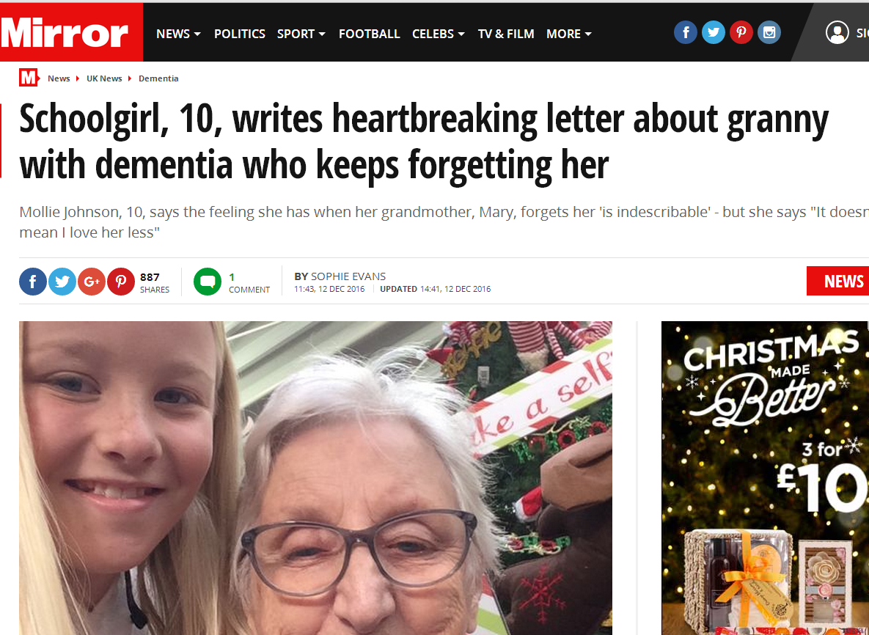
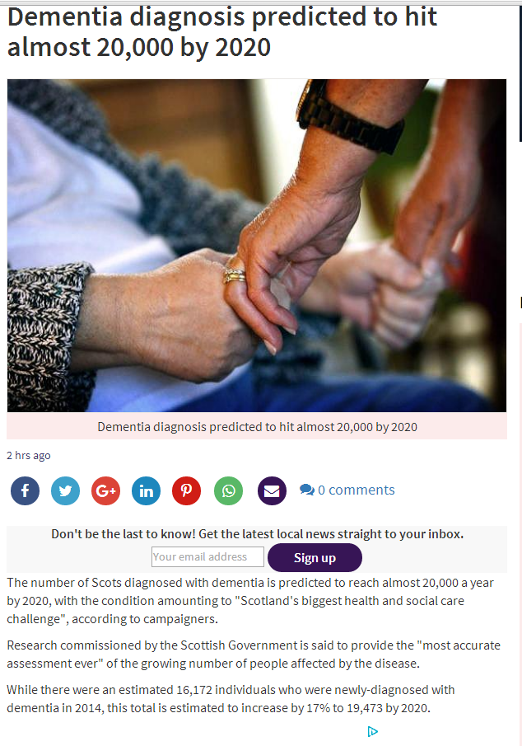
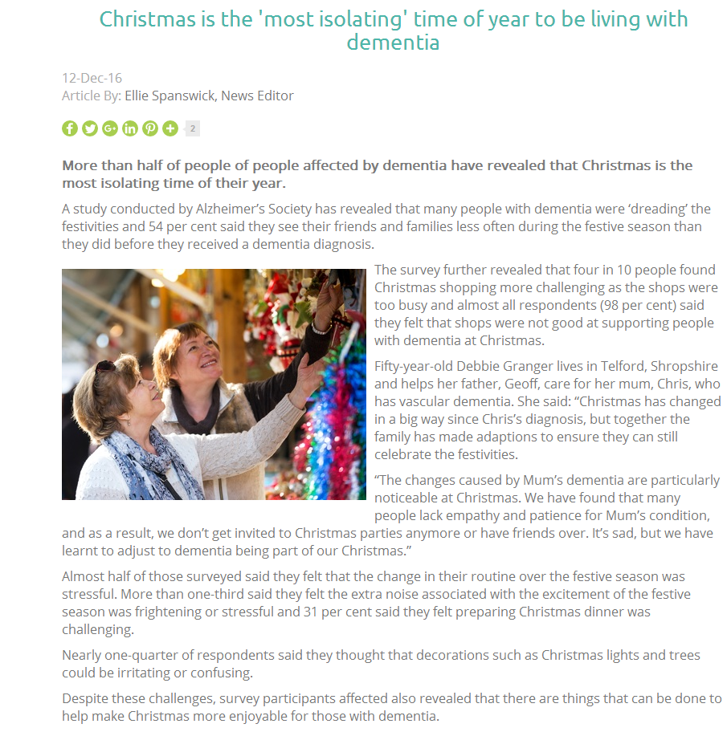
http://www.mirror.co.uk/news/uk-news/it-doesnt-mean-love-less-9442046
https://www.homecare.co.uk/news/article.cfm/id/1580577/christmas-time-is-the-most-isolating-time-of-the-year-for-people-with-dementia
http://www.eveningtimes.co.uk/news/14963406.Dementia_diagnosis_predicted_to_hit_almost_20_000_by_2020/?ref=rss

Slide 9
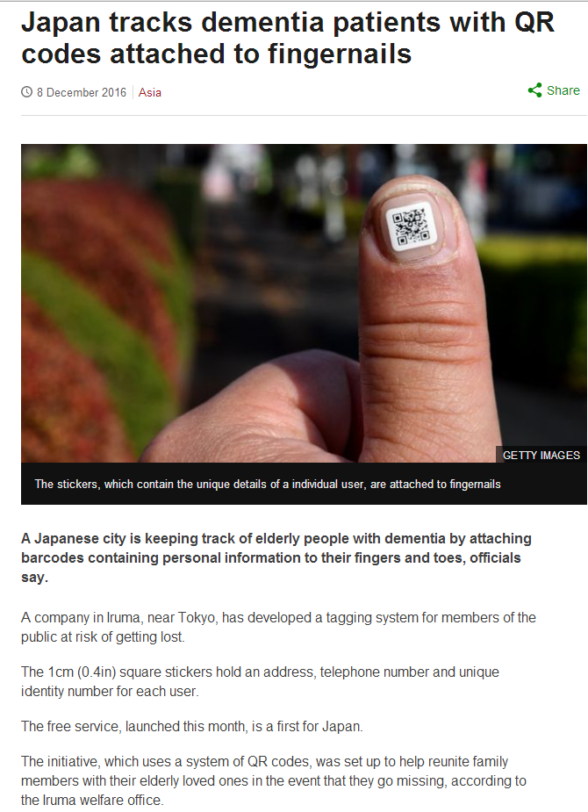
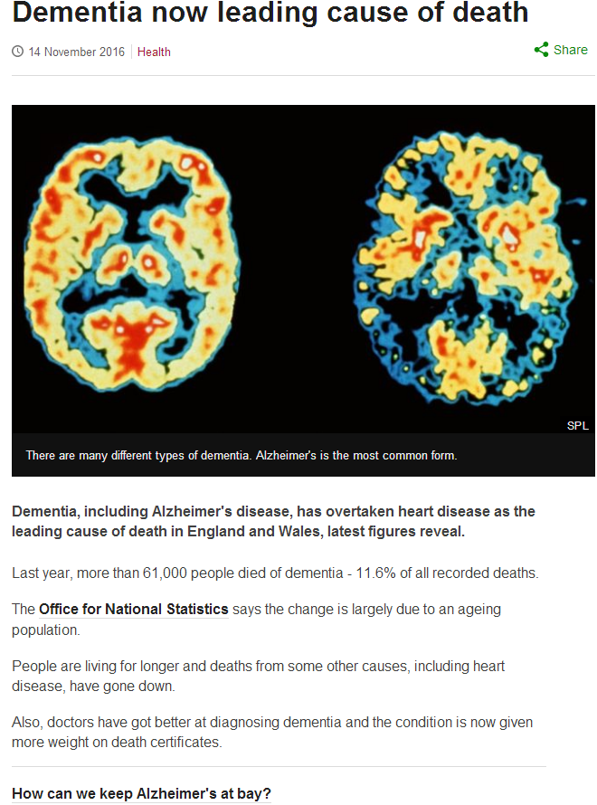
http://www.bbc.co.uk/news/world-asia-38247437
http://www.bbc.co.uk/news/health-37972141

Slide 10
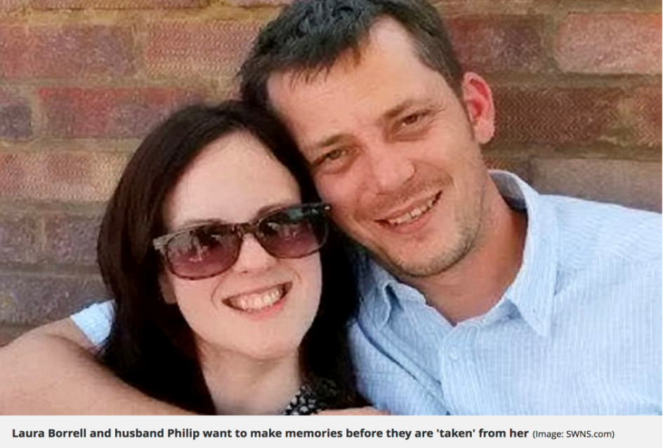
It’s not just old people
Woman fighting dementia aged 39 wants to take road trip to 'make memories' with husband.
Laura Borrell was forced to give up her law degree because of the illness and now wants to spend as much time as possible with husband Paul.
http://www.mirror.co.uk/news/uk-news/wife-fighting-dementia-aged-just-9626873

Slide 11
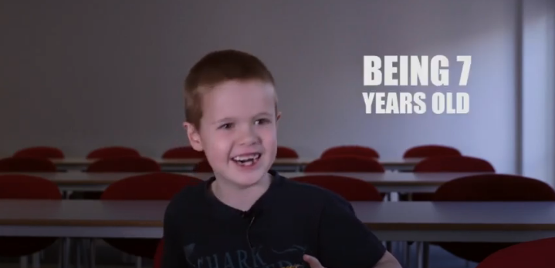
What is dementia?
In groups, can you describe dementia in a single sentence?
Would your sentence make sense to a 7 year old?
This film will give you an idea of how 7 year olds think.
https://youtu.be/609ZoEGcbjo

Slide 12
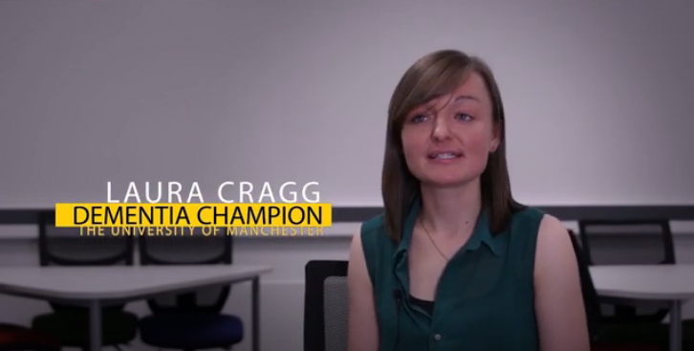
What is dementia?
Laura Cragg, a Dementia Friends Champion Volunteer – 5 key messages from Dementia Friends.
https://youtu.be/ZRPHbV_3U2c

Slide 13
Dementia 5 key messages
Dementia is not a natural part of ageing
Dementia is caused by brain diseases
Dementia is not just about losing your memory
It’s possible to live well with dementia
There’s more to a person than dementia
For further information see: Dementia Friends
How does this information change your ‘dementia in a sentence’?

Slide 14
WHAT IS DEMENTIA?

